Slide 1
Reading report
Dynamic Replication and
Hedging: A Reinforcement
Learning Approach
Petter N. Kolm and Gordon Ritter

Slide 2
Table of contents
The problem to solve
Main idea of the paper
environment setup in the paper
Results
Performance analysis
Reimplementation
My results
Critics and further ideas
Conclusion

Slide 3
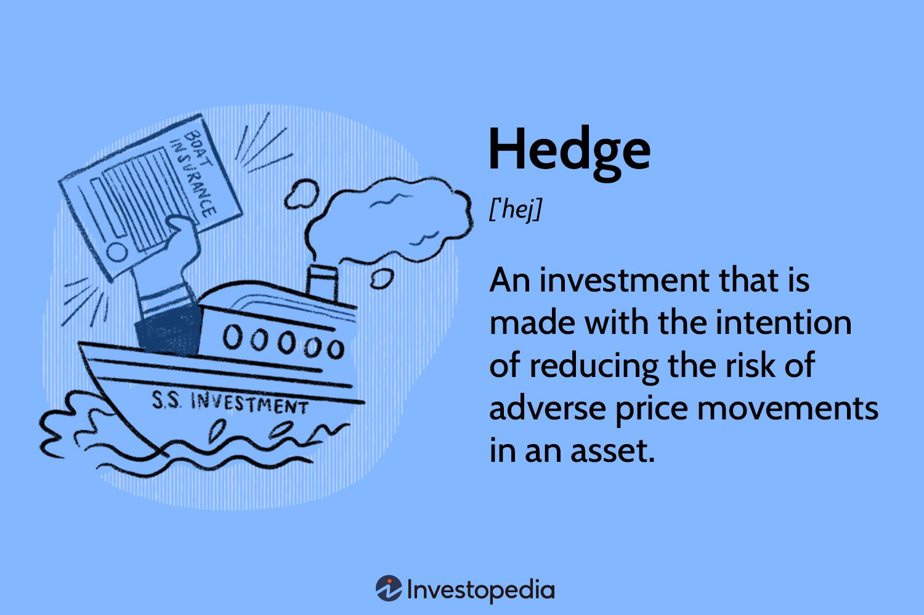
The problem to solve :
Hedging financial derivative
With discretization constraints (discrete time trading, discrete trading amount)
Market friction (transaction cost, market impact...)

Slide 4


Main idea of the paper
Objective : Mean-Variance optimization of the final wealth
κ = 0.1
Reinforcement learning :
State : Underlying current price, option remaining time, underlying share number
Reward :
With ε-greedy
Training time : 1 day, over 15000 episodes of 50 steps

Slide 5

environment setup
The underlying follows BS dynamic
Volatility = 0.01, S0 = 100, T = 10, and D = 5
Quadratic trading cost :
cost(n) = multiplier x TickSize × ( |n|+ 0.01*n**2 )
TickSize = 0.1

Slide 6
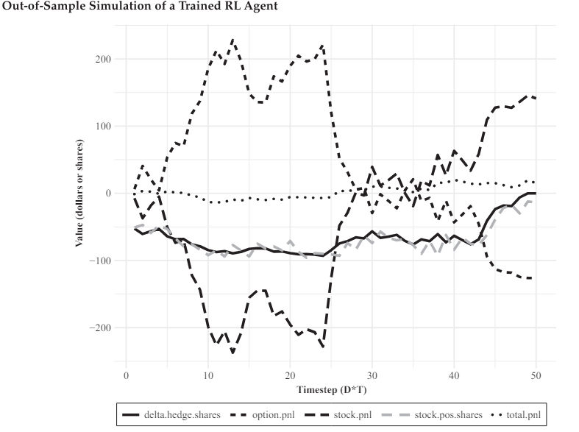
Results
Without trading cost, Multiplyer = 0

Slide 7
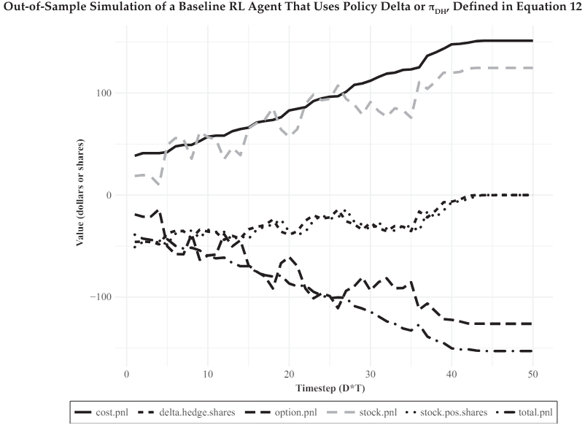
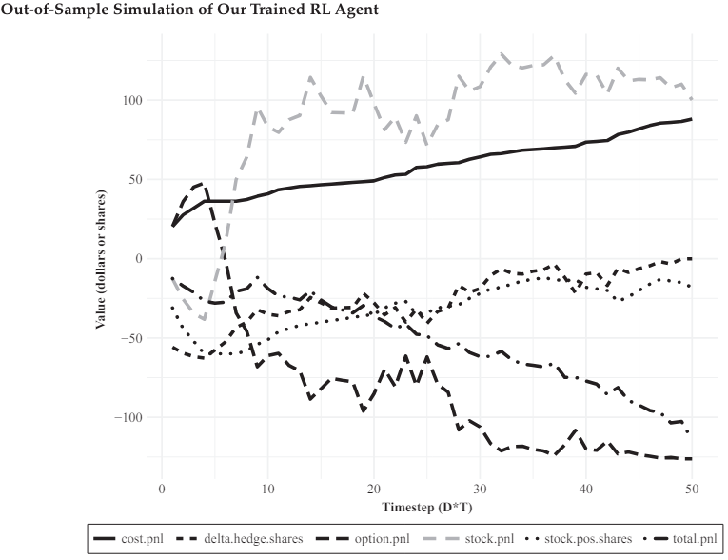
With trading cost, Multiplyer = 5

Slide 8
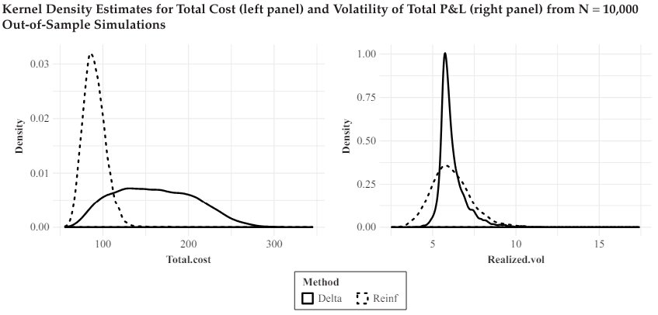
Performance analysis
The RL agent avoid over-trading
The hedging cost is better (statistically significant) with the RL agent
No statistical sifference between 2 methods in term of volatility
Other strengths :
No need to compute greeks
No need of the existence of perfect dynamic replication
Doesn't need a trading cost model
Not limited on finite state space

Slide 9
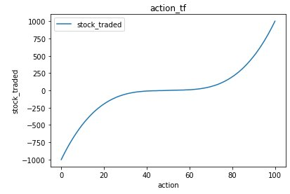
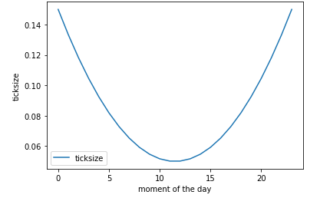
Reimplementation
Same environment setup
Training time : 1 hour, 100 episodes of 50 steps
Improvement :
Varying cost function that depends on the moment of the day
A transformation of the action to have a good trade off between maximizing precision on little adjustements and while covering a large range of trading quantity with a small action space.

Slide 10
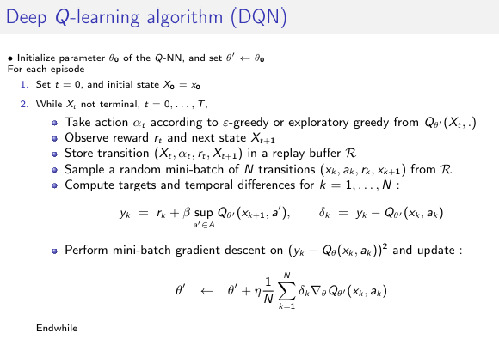

Slide 11
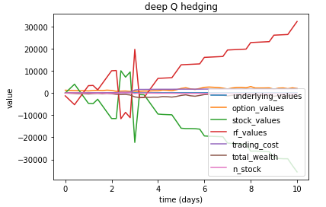
My results

Slide 12
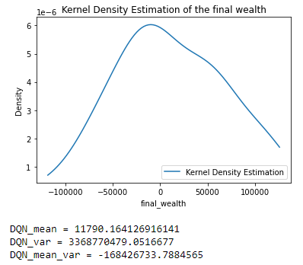
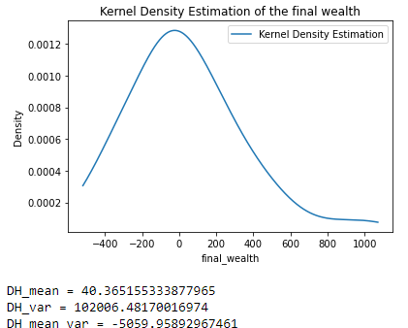
Without trading cost

Slide 13
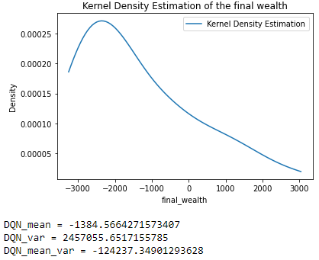
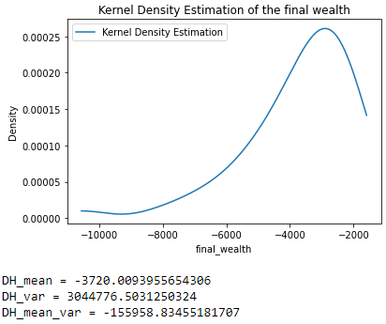
With trading cost (multiplier = 5)

Slide 14
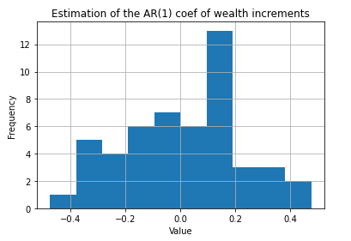

Critics and further ideas
Independant wealth increment assumption
= > ?
Solution ?? : Fit a model to estimate temporal dependency while training, use the model to update the reward function during training, and use further wealth increment to update the model
2) "any option that can be priced can also be hedged" But it still needs a "good" derivative pricer.
Solution ? : Train alternatively on the Q network and a pricing network.

Slide 15
Conclusion
Effectiveness of Deep Q-learning in Real-world Hedging
Flexible and efficient under real-world constraints
Outperforms traditional methods in diverse scenarios with limited resources
Limitations
Some assumptions may not be satisfied
Pricer dependant
Future Applicability and Complex Scenarios
more complex derivatives
Portfolio management
Underlyings with more discontinous dynamics

